Slide 1
Chapter 1
Introduction to Business Intelligence

Slide 2
Learning Objectives
Understand today’s turbulent business environment and describe how organizations survive and even excel in such an environment (solving problems and exploiting
opportunities)
Understand the need for computerized support of managerial decision making
Describe the business intelligence (BI) methodology and concepts and relate them to DSS
Understand the major issues in implementing business intelligence

Slide 3
Changing Business Environments and Computerized Decision Support
The Business Pressures-Responses-Support Model
  The business environment
  Organizational responses: be reactive, anticipative, adaptive, and proactive
  Computerized support
    Closing the Strategy Gap One of the major objectives of BI is to facilitate closing the gap between the current performance of an organization and its desired performance as expressed in its mission, objectives, and goals and the strategy for achieving them

Slide 4
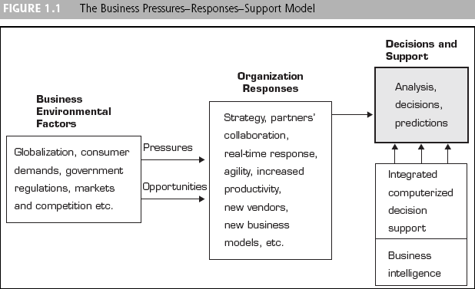
Changing Business Environments and Computerized Decision Support

Slide 5
A Framework for
Business Intelligence (BI)
business intelligence (BI)
A conceptual framework for decision support. It combines architecture, databases (or data warehouse), analytical tools and applications

Slide 6
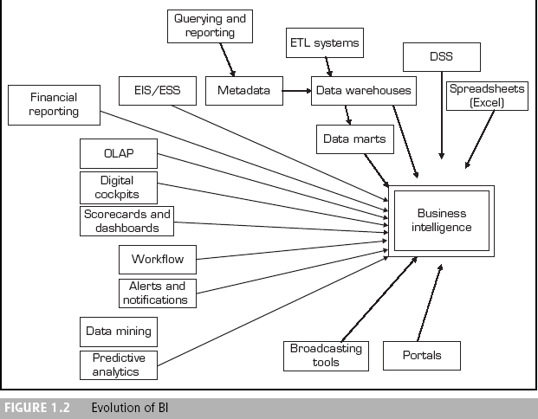
A Framework for
Business Intelligence

Slide 7
A Framework for
Business Intelligence (BI)
The Origins and Drivers of Business Intelligence
  Organizations are being compelled to capture, understand, and harness their data to support decision making in order to improve business operations
  Managers need the right information at the right time and in the right place

Slide 8
A Framework for
Business Intelligence (BI)
BI’s Architecture and Components
  Data Warehouse
  Business Analytics
    Automated decision systems
  Performance and Strategy

Slide 9
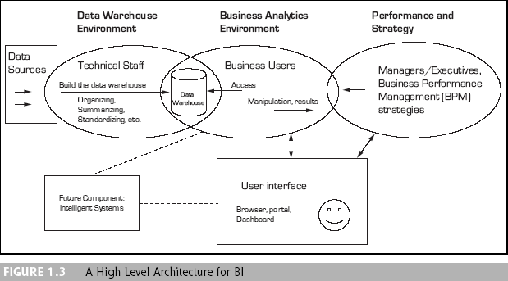
A Framework for
Business Intelligence (BI)

Slide 10
A Framework for
Business Intelligence (BI)
BI’s Architecture and Components
  Data Warehouse
  Business Analytics
    Automated decision systems

Slide 11
A Framework for
Business Intelligence (BI)
BI’s Architecture and Components
  Data Mining
  A class of information analysis based on databases that looks for hidden patterns in a collection of data which can be used to predict future behavior

Slide 12
A Framework for
Business Intelligence (BI)
BI’s Architecture and Components
  business (or corporate) performance management (BPM)
  A component of BI based on the balanced scorecard methodology, which is a framework for defining, implementing, and managing an enterprise’s business strategy by linking objectives with factual measures

Slide 13
A Framework for
Business Intelligence (BI)
BI’s Architecture and Components
  User Interface: Dashboards and Other Information Broadcasting Tools
    Dashboards
    A visual presentation of critical data for executives to view. It allows executives to see hot spots in seconds and explore the situation

Slide 14
A Framework for
Business Intelligence (BI)
The Benefits of BI
Time savings
Single version of truth
Improved strategies and plans
Improved tactical decisions
More efficient processes
Cost savings
Faster, more accurate reporting
Improved decision making
Improved customer service
Increased revenue

Slide 15
A Framework for
Business Intelligence (BI)
The Business Value of BI
  How BI Can Help
    Assess their readiness for meeting the challenges posed by these new business realities
    Take a holistic approach to BI functionality
    Leverage best practices and anticipate hidden costs

Slide 16
A Framework for
Business Intelligence (BI)
The Business Value of BI
  Key Issues and Framework for BI Analysis
    How can enterprises maximize their BI investments?
    What BI functionality do enterprises need, and what are they using today?
    What are some of the hidden costs associated with BI initiatives?

Slide 17
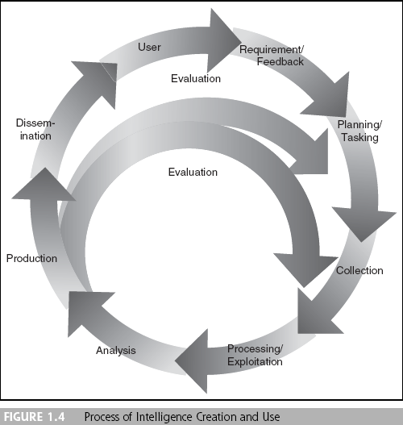
Intelligence Creation and Use and BI Governance

Slide 18
Intelligence Creation and Use and BI Governance
BI Governance
The project prioritization process within organizations

Slide 19
Intelligence Creation and Use and BI Governance
A typical set of issues for the BI governance team is to address
  Creating categories of projects (investment, business opportunity, strategic, mandatory, etc.)
  Defining criteria for project selection
  Determining and setting a framework for managing project risk
  Managing and leveraging project interdependencies
  Continually monitoring and adjusting the composition of the portfolio

Slide 20
Intelligence Creation and Use and BI Governance
Intelligence Gathering
  How modern companies ethically and legally organize themselves to glean as much information as they can from their:
    Customers
    Business environment
    Stakeholders
    Business processes
    Competitors
    Other sources of potentially valuable information

Slide 21
Intelligence Creation and Use and BI Governance
Intelligence Gathering
  In order to be useful in decision making and improving the bottom line, the data must be:
    Cataloged
    Tagged
    Analyzed
    Sorted
    Filtered

Slide 22
The Major Theories and
Characteristics of Business Intelligence
online transaction processing systems (OLTP)
Systems that handle a company’s routine ongoing business
online analytic processing (OLAP)
An information system that enables the user, while at a PC, to query the system, conduct an analysis, and so on. The result is generated in seconds

Slide 23
The Major Theories and
Characteristics of Business Intelligence
Some Theories of BI
  A factory and warehouse
  The information factory
  Data warehousing and business intelligence
  Teradata advanced analytics methodology
  Oracle BI system

Slide 24
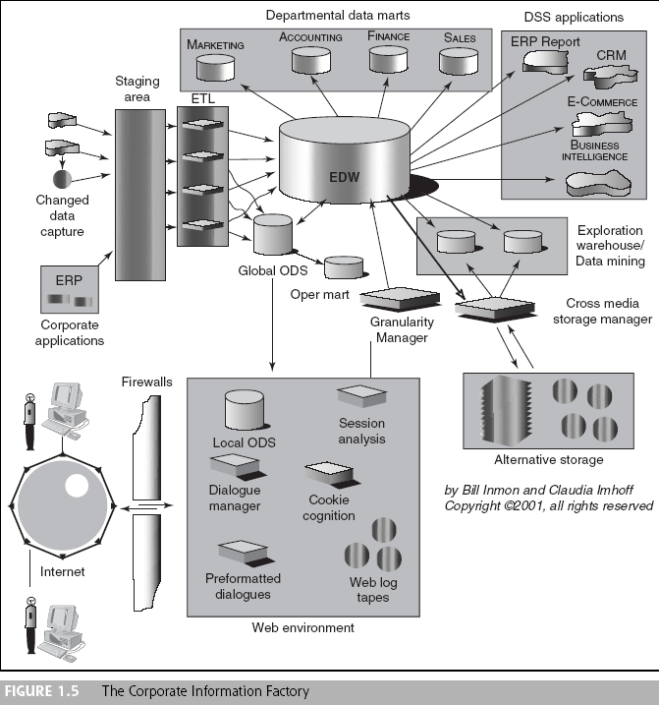
The Major Theories and
Characteristics of Business Intelligence

Slide 25
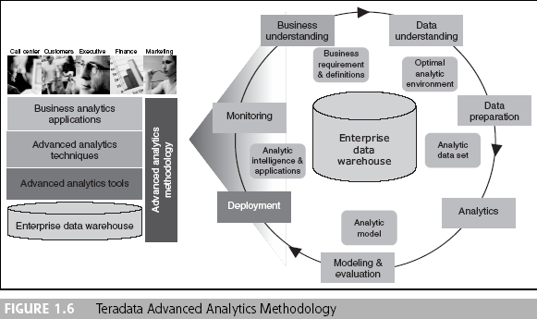
The Major Theories and
Characteristics of Business Intelligence

Slide 26
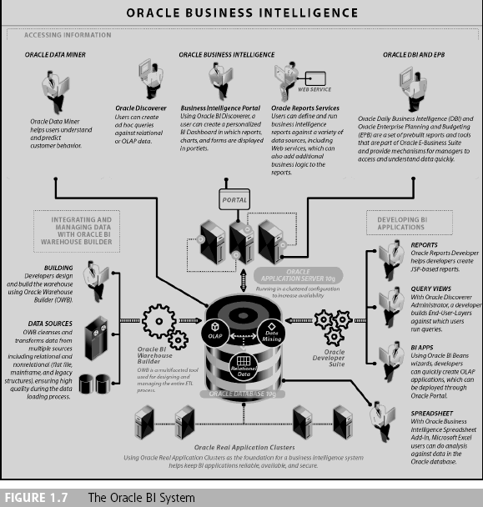
The Major Theories and
Characteristics of Business Intelligence

Slide 27
Toward Competitive
Intelligence and Advantage
The Strategic Imperative of BI
  Barriers to entry of a new competitor are being significantly diminished
  Because of the Web revolution and increasing globalization, companies throughout the world are challenging major players in industries
  The ability to deliver goods worldwide is making it easier for potential competitors to get products and services to more customers almost anywhere
  Companies are finding better or less expensive suppliers all over the globe

Slide 28
Toward Competitive
Intelligence and Advantage
Competitive Intelligence (CI)
  CI implies tracking what competitors are doing by gathering material on their recent and in-process activities
  Competitive strategy in an industry
    low-cost leader
    market niche
  Sustaining competitive advantage through building brand and customer loyalty using BI applications

Slide 29
Successful
Business Intelligence Implementation
The Typical BI User Community
  IT staff
  Power users
  Executives
  Functional managers
  Occasional information customers
  Partners
  Consumers

Slide 30
Successful
Business Intelligence Implementation
Appropriate Planning and Alignment with the Business Strategy
  Planning and execution components
    Business
    Organization
    Functionality
    Infrastructure
Establish a BI Competency Center (BICC) within the Company

Slide 31
Successful
Business Intelligence Implementation
Real-time, On-Demand BI Is Attainable
Developing or Acquiring BI Systems
Justification and Cost/Benefit Analysis
Security and Protection of Privacy
Integration of Systems and Applications

Slide 32
Conclusion:
Business Intelligence Today and Tomorrow
Today’s organizations are deriving more value from BI by extending actionable information to many types of employees, maximizing the use of existing data assets
Visualization tools including dashboards are used by producers, retailers, governments, and special agencies

Slide 33
Conclusion:
Business Intelligence Today and Tomorrow
More and more industry-specific analytical tools will flood the market to perform almost any kind of analysis and to facilitate informed decision making from the top level to the user level
A potential trend involving BI is its possible merger with artificial intelligence (AI)

